Slide 1
MDI Applications & Menus ADO.NET & Data Classes

Slide 2
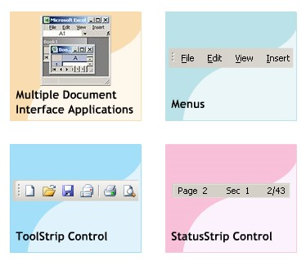
Objectives
Multiple Document Interface (MDI)
Menus
ToolStrip control
StatusStrip control
ADO.NET
Data Classes

Slide 3
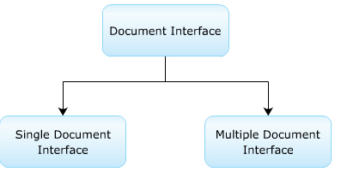
Windows Form
There are basically two types of document :
Single Document Interface (SDI)
Multiple Document Interface (MDI)

Slide 4
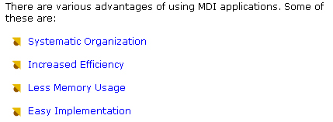
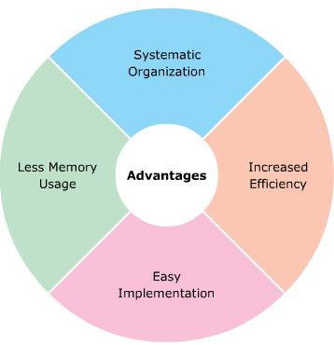
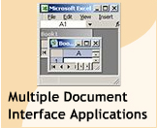
Advantages of MDI Applications

Slide 5
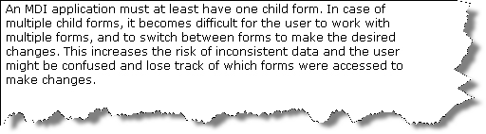
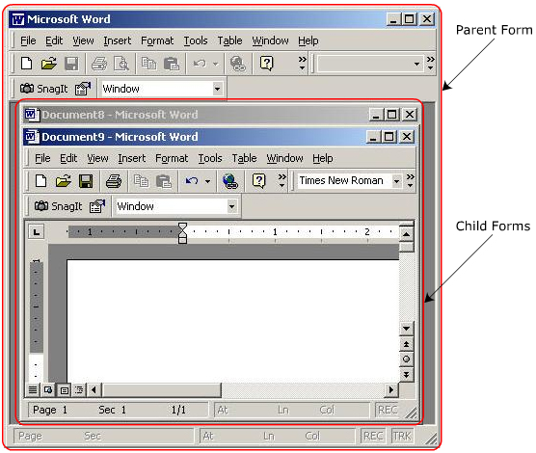
Disanvatages of MDI Application

Slide 6
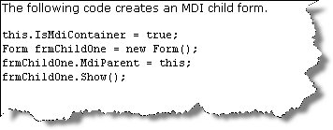
MDI Child forms
The sub-form that are opened within the parent form
When the parent form is closed, all the child forms associated also closed

Slide 7
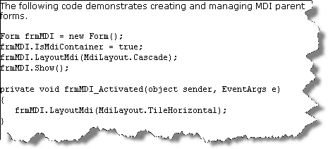
Properties Methods Events
PROPERTIES
ActiveMdiChild
IsMdiChild
IsMdiContainer
MdiChidren
MdiParent
Methods
ActivateMdiChild
Show
LayoutMdi
Event
MdiChildActive

Slide 8
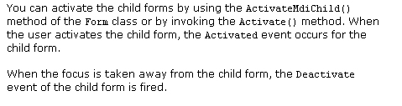
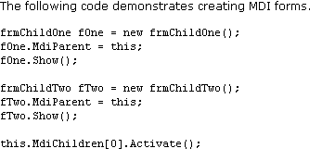
Activating and Deactivating Forms

Slide 9

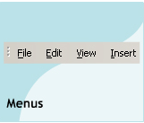
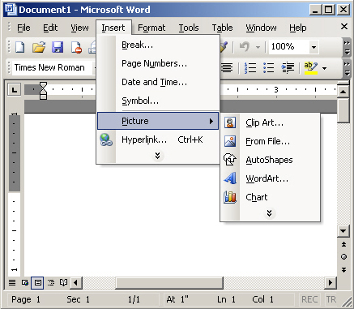
Menus System

Slide 10
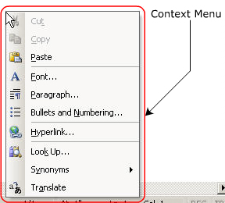
Menus System
There are two types of menus
Main menu ( appears on the menu bar of the form )
Context Menu : popup menu (when right click mouse)

Slide 11
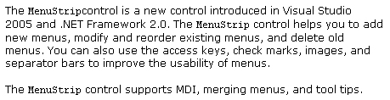
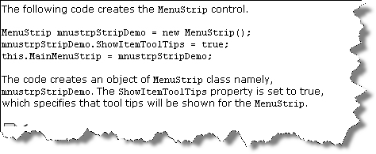
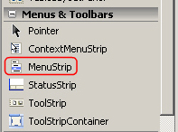
MenuStrip

Slide 12
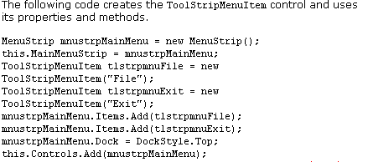
ToolStripMenuItem
Properties
AllowMerge
LayoutStyle
ShowItemTooltip
Stretch
GetItemAt
MenuActivate
MenuDeactivate
Checked
CheckState
Select

Slide 13
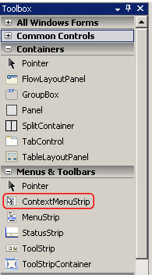
ContextMenuStrip
Provide a short cut for accessing menu
Similar to the context menu
Properties
SourceControl
TextDirection
Methods
IsParent
MdiListItem
MenuItems
GetContextMenu
GetMainMenu
MergeMenu

Slide 14
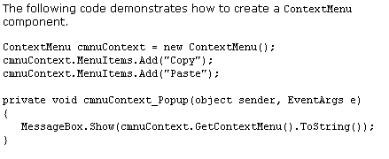
MainMenu
Contains a collection of the MenuItem class
Properties
MenuItems
RightToLeft
SourceControl
Methods
GetForm
GetMainMenu
FindMenuItem
Show
Events
Popup
Collapse

Slide 15
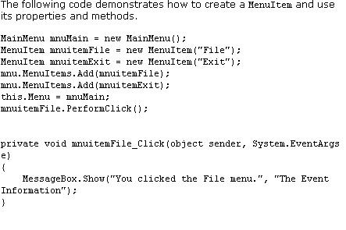
MenuItems Class

Slide 16
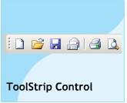
ToolStrip control
The ToolStrip control is a new control in .Net Framework 2.0.
The ToolStrip control is used to create the ToolStrip control.
When this control is palced on the form you can add buttons, lables, seperators, combo boxes, and drop down buttons using the ToolStrip control.
ImageList
Items
LayoutStyle
GetNextItem(..)
Properties
Methods
ItemAdded
ItemClicked
ItemRemoved
Events

Slide 17
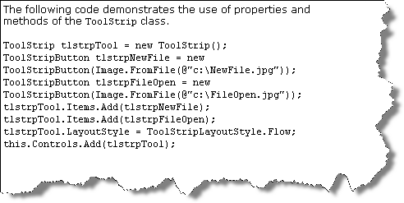
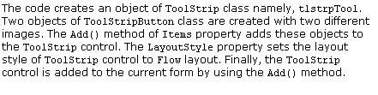
ToolStrip control

Slide 18
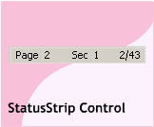
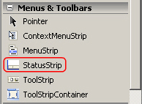
StatusStrip control
StatusStrip control is a new control introduced in .Net Framewok 2.0.
The default StatusStrip control has no panel and displayed at the bottom of the form.
To add panels to a StatusStrip control, you use the ToolStripItemCollection.AddRange method, or use the StatusStrip Items Collection Editor at design time.

Slide 19
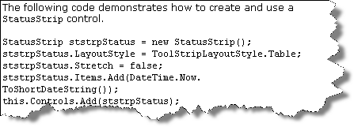
StatusStrip control
Properties
LayoutStyle
Stretch
Dock
Event
ItemAdded

Slide 20
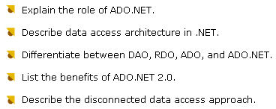

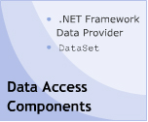

ADO.NET

Slide 21
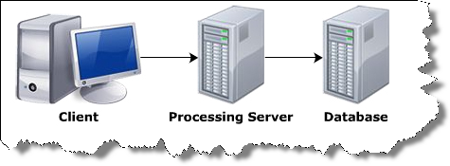

ADO.Net Architecture
The informationin the database is stored in such a way that it is easier to access, manage, and update the data.
Data from the database can be accessed using any one of the following architectures.

Slide 22
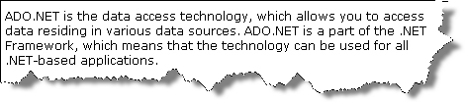
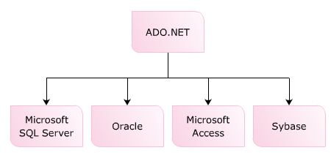
ADO.NET

Slide 23
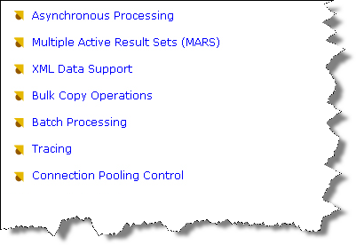
Features

Slide 24

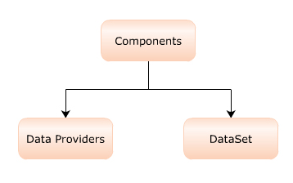
Data Access Architecture

Slide 25

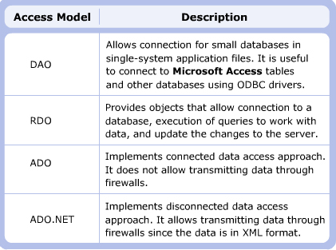
Different Data Access Model

Slide 26
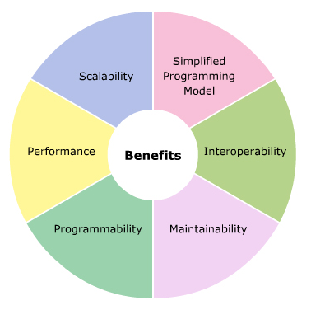
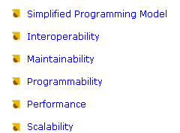
Advantages of ADO.Net 2.0

Slide 27

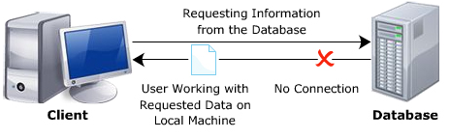
Connected vs Disconnected Data Access
ADO uses connected data access approach. In this approach connection to a database is established when requested by an application.
This connection is kept open till the application is closed.
ADO.net 2.0

Slide 28
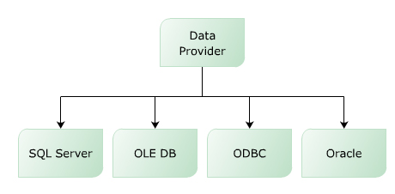
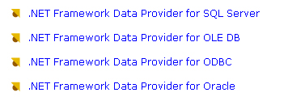
Data Provider
Used for providing and maintaining connection to the Database
Allows to perform different operations in the database

Slide 29
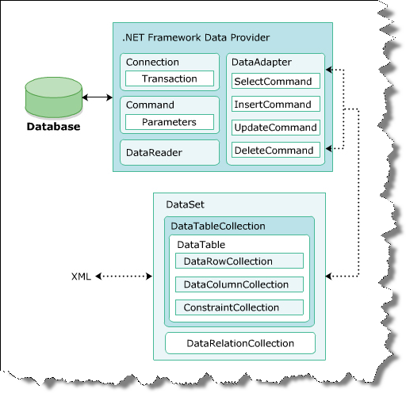

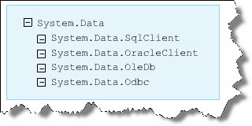
ADO.Net
ADO.NET provides two components to access and manipulate data :

Slide 30
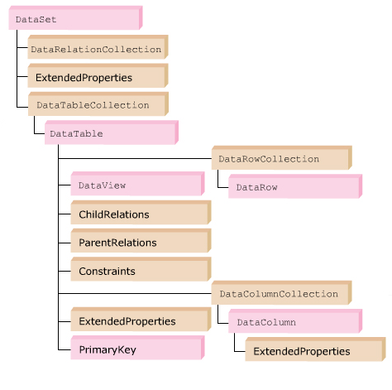
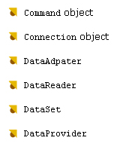
Data Access Component - DataSet

Slide 31
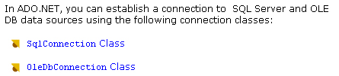
Connection
string strConnect = “server=(local);database=pubs;uid=sa;pwd=sa”;
SqlConnection con = new SqlConnection(strConnect);

Slide 32
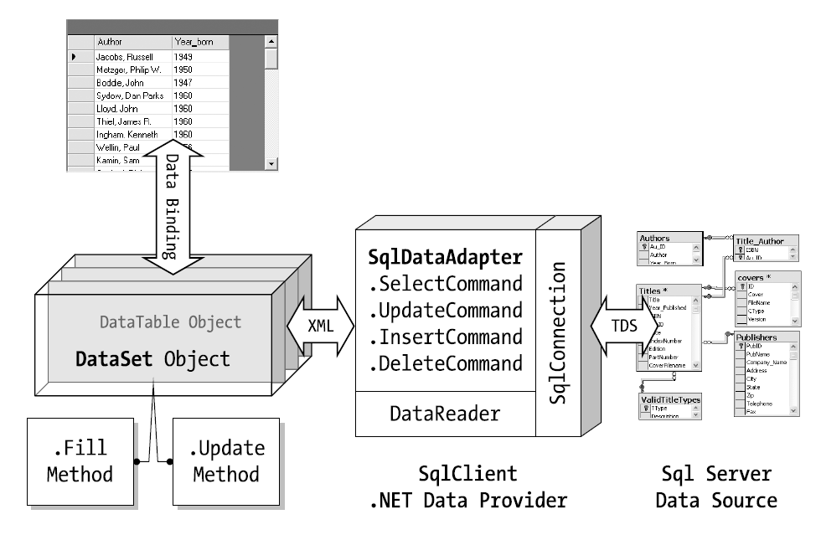

Slide 33
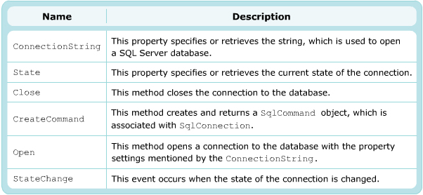
SqlConnection class
ConnectionString
State
Close
CreateCommand
Open
StateChange

Slide 34
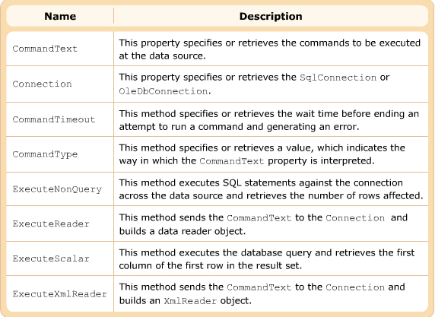
Command Object
Allows make a call to a stored procedure
Execute SQL statements : INSERT , DELETE , UPDATE and SELECT

Slide 35
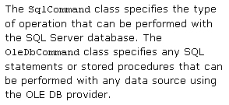
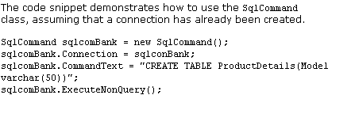
SqlCommand class

Slide 36

DataAdapter
A bridge between a DataSet and a DataSource
Fill() method to fill DataSet from DataSource
Update() method used to INSERT,UPDATE or DELETE data from DataSource
There are many kinds of DataAdapter
OleDbDataAdapter
SqlDataAdapter
OdbcDataAdapter
OracleDataAdapter

Slide 37

DataReader
SqlDataReader reader = commandObj . ExecuteReader();
Increase the application performace by reading only one row at a time
However the DataReader object requires an exclusive use of an open connection object fot its whole life span

Slide 38
Data Classes
Data Classes
DataAdapter
DataReader
DataSet
DataTable

Slide 39

DataAdapter Properties

Slide 40


Demo
SqlDataAdapter is the best way to load data from server to DataSet

Slide 41

SqlDataAdapter : properties - Events
DeleteCommand
InsertCommand
SelectCommand
UpdateCommand
RowUpdate
RowUpdating
SqlDataAdapter dataAdapt = new SqlDataAdapter();
SqlCommand cmd = new SqlCommand(“Select * from authors” , con);
dataAdapt.SelectCommand = cmd ;
DataSet ds = new DataSet();
dataAdapt.Fill(ds);

Slide 42

OleDbDataAdapter
Used to connect to multiple databses such as : SQLServer , Access , Oracle
Exists in the namespace : System.Data.OleDb
Have the same properties and events as SqlDataAdapter

Slide 43


SqlDataReader class
Used to read data from SQL Server in a sequential manner and have some properties :
Forward-only - Read Only
Get it by call the ExecuteReader() method of SqlCommand object
Read data by Read() method
FieldCount
HasRow
IsClosed
Item
RecordsAffected

Slide 44



SqlDataReader : Method

Slide 45


DataSet
A representation of a database in cached-memory
Included datatable and relation and contrains
Ex : DataSet ds = new DataSet()

Slide 46

Method – Kind of DataSet
TypeDataSet :
Have a schema : .xsd
UntypeDataSet :
Create by a code :
DataSet A = new DataSet()
Navigate Record :
Using Binding source class and use some methods of this class as :
MoveFirst
MoveLast
MoveNext
MovePrevious

Slide 47


DataSet and XML
DataSet can fetch data from a XML file
ReadXML(string path) : read XML file to DataSet
WriteXML(string path) : save the content DataSet to a XML file

Slide 48


DataTable class
Represent a table in DataSet
Have a constraint objects that ensure data integrity
Properties

Slide 49


Method

Slide 50


DataTable: Event

Slide 51


DataTableCollection
The DataTableCollection class is a collection of the tables in DataSet
Collection of the DataTable class

Slide 52



DataRelation
Maintains referential integrity by enforcing foreign-key constraint
Unique constraint
Cascade update and delete operation
Use to relate two DataColumn Object that exits in two DataTable

Slide 53


DataColumn class
Used for creating a schema for a particular column
You can add a column to a DataColumnCollection

Slide 54



DataRow class
Represent a row in a DataTable

Slide 55




DataTableReader

Slide 56


DataTableReader
DataTableReader dtr = dataTable.CreateDataReader()

Slide 57


Demo

